Slide 1
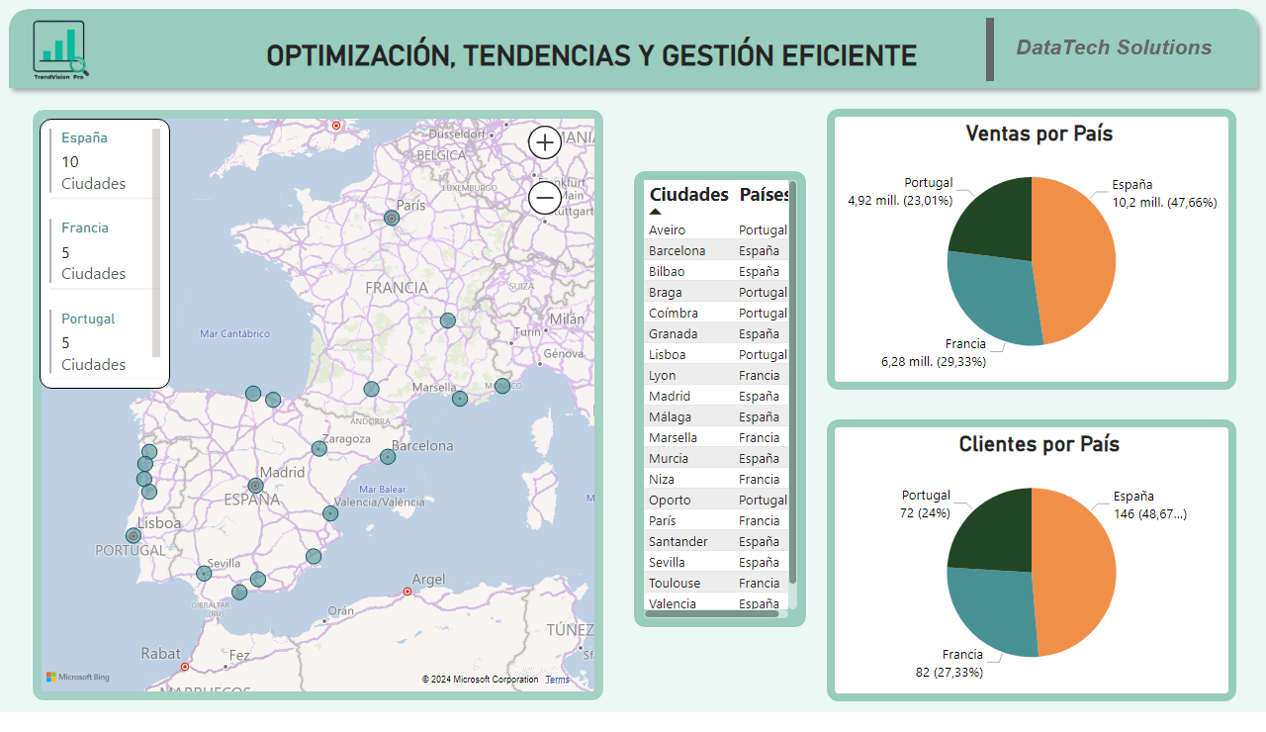
Dashboard Datos Generales
Notes:
Clientes por País
No alt text provided
Ventas por País
No alt text provided
map
No alt text provided
tableEx
No alt text provided
multiRowCard
No alt text provided
image
No alt text provided
shape
No alt text provided
textbox
No alt text provided
shape
No alt text provided
textbox
No alt text provided

Slide 2
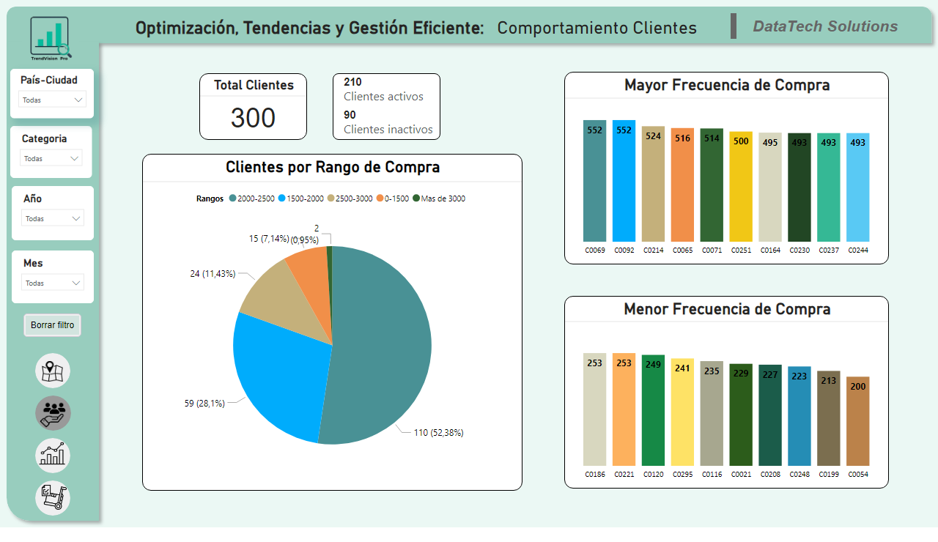
Dashboard Comportamiento Clientes
Notes:
shape
No alt text provided
image
No alt text provided
image
No alt text provided
shape
No alt text provided
shape
No alt text provided
Categoría
No alt text provided
Año
No alt text provided
Mes
No alt text provided
textbox
No alt text provided
shape
No alt text provided
textbox
No alt text provided
image
No alt text provided
image
No alt text provided
shape
No alt text provided
shape
No alt text provided
shape
No alt text provided
image
No alt text provided
actionButton
No alt text provided
Mayor Frecuencia de Compra
No alt text provided
Clientes por Rango de Compra
No alt text provided
Menor Frecuencia de Compra
No alt text provided
slicer
No alt text provided
Total Clientes
No alt text provided
multiRowCard
No alt text provided

Slide 3
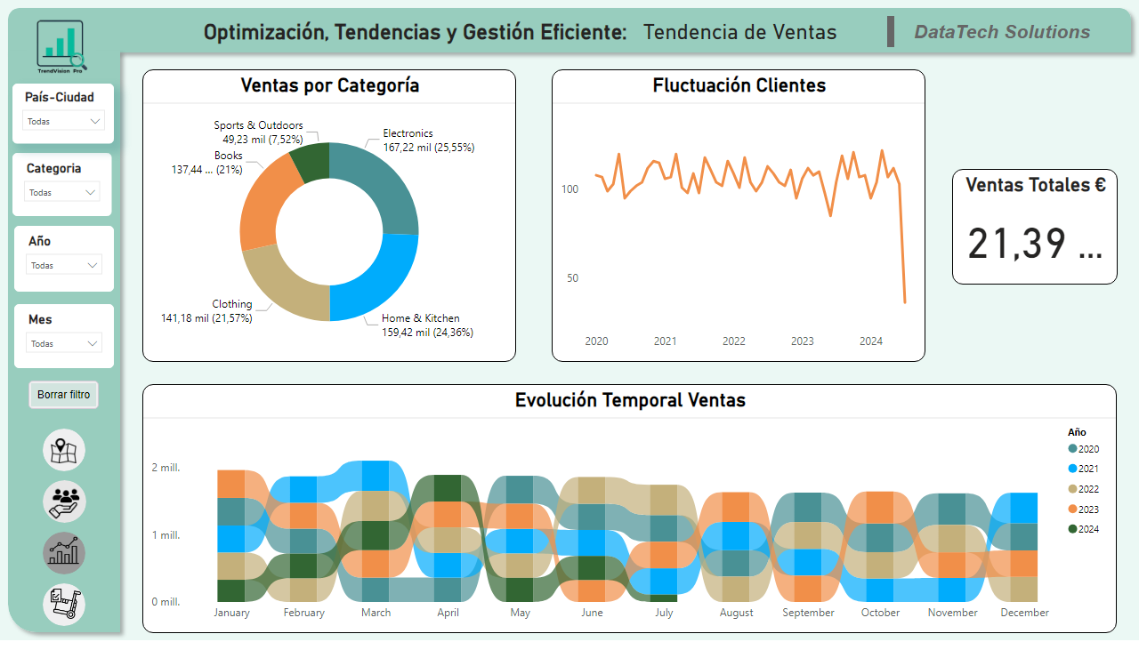
Dashboard Tendencias Ventas
Notes:
Ventas por Categoría
No alt text provided
Fluctuación Clientes
No alt text provided
Evolución Temporal Ventas
No alt text provided
Categoría
No alt text provided
Año
No alt text provided
Mes
No alt text provided
shape
No alt text provided
textbox
No alt text provided
image
No alt text provided
image
No alt text provided
shape
No alt text provided
shape
No alt text provided
shape
No alt text provided
image
No alt text provided
actionButton
No alt text provided
image
No alt text provided
slicer
No alt text provided
shape
No alt text provided
image
No alt text provided
image
No alt text provided
shape
No alt text provided
shape
No alt text provided
textbox
No alt text provided
Ventas Totales €
No alt text provided

Slide 4
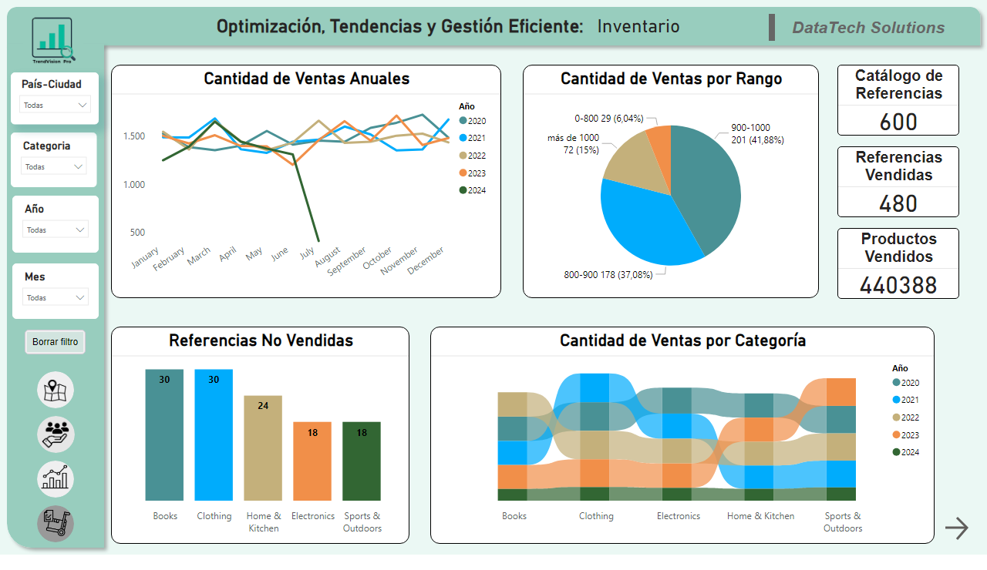
Dashboard Inventario
Notes:
Cantidad de Ventas Anuales
No alt text provided
Cantidad de Ventas por Rango
No alt text provided
Referencias No Vendidas
No alt text provided
Cantidad de Ventas por Categoría
No alt text provided
Catálogo de Referencias
No alt text provided
Referencias Vendidas
No alt text provided
Categoría
No alt text provided
Año
No alt text provided
Mes
No alt text provided
shape
No alt text provided
textbox
No alt text provided
image
No alt text provided
image
No alt text provided
shape
No alt text provided
shape
No alt text provided
shape
No alt text provided
image
No alt text provided
actionButton
No alt text provided
slicer
No alt text provided
shape
No alt text provided
image
No alt text provided
image
No alt text provided
shape
No alt text provided
shape
No alt text provided
actionButton
No alt text provided
Productos Vendidos
No alt text provided
textbox
No alt text provided

Slide 5
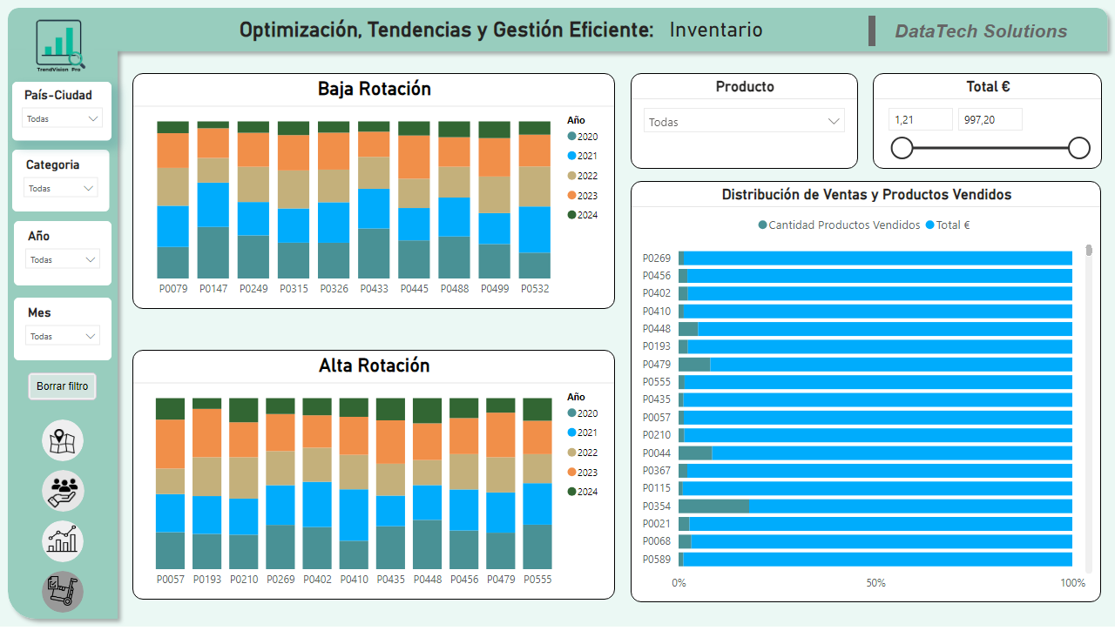
Dashboard Inventario2
Notes:
Alta Rotación
No alt text provided
Baja Rotación
No alt text provided
Distribución de Ventas y Productos Vendidos
No alt text provided
Total €
No alt text provided
Producto
No alt text provided
Categoría
No alt text provided
Año
No alt text provided
Mes
No alt text provided
shape
No alt text provided
textbox
No alt text provided
image
No alt text provided
image
No alt text provided
shape
No alt text provided
shape
No alt text provided
shape
No alt text provided
image
No alt text provided
actionButton
No alt text provided
slicer
No alt text provided
shape
No alt text provided
image
No alt text provided
image
No alt text provided
shape
No alt text provided
shape
No alt text provided
textbox
No alt text provided

Slide 6
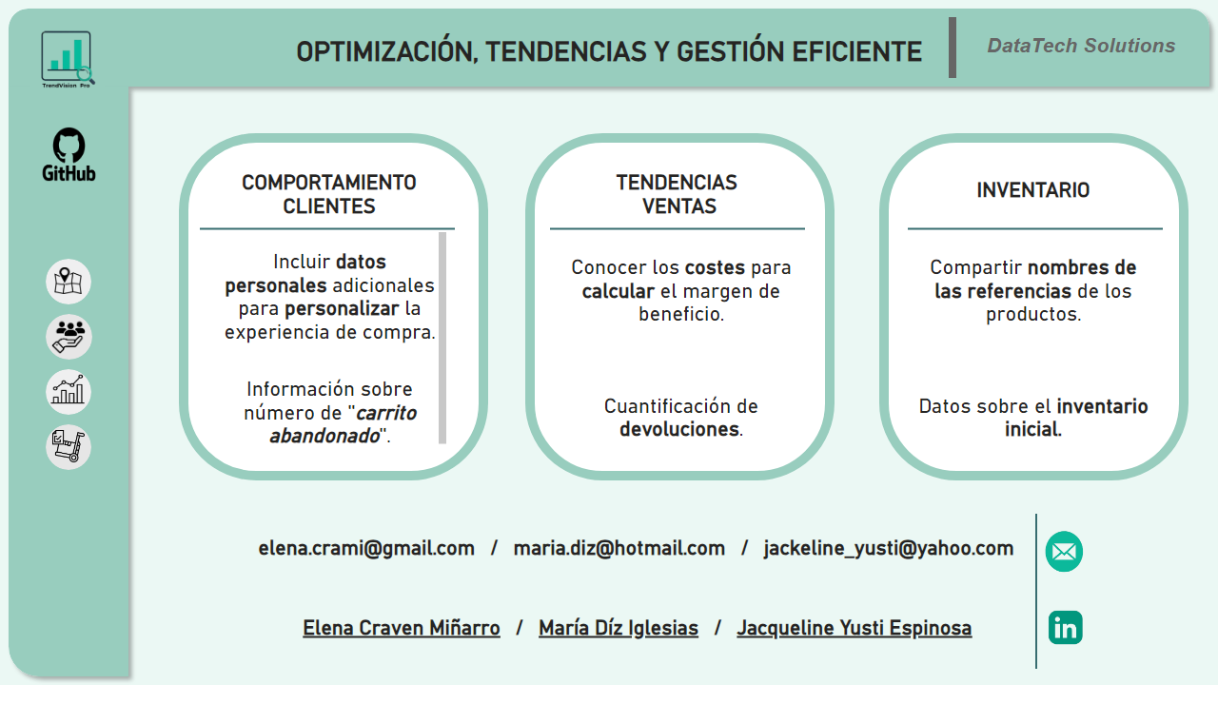
Dashboard Contraportada
Notes:
image
No alt text provided
image
No alt text provided
shape
No alt text provided
image
No alt text provided
shape
No alt text provided
shape
No alt text provided
shape
No alt text provided
image
No alt text provided
shape
No alt text provided
image
No alt text provided
image
No alt text provided
shape
No alt text provided
textbox
No alt text provided
textbox
No alt text provided
textbox
No alt text provided
textbox
No alt text provided
shape
No alt text provided
shape
No alt text provided
textbox
No alt text provided
textbox
No alt text provided
textbox
No alt text provided
textbox
No alt text provided
image
No alt text provided
image
No alt text provided
shape
No alt text provided
shape
No alt text provided
shape
No alt text provided
shape
No alt text provided
shape
No alt text provided
textbox
No alt text provided
shape
No alt text provided
textbox
No alt text provided

